Slide 1
Introduction to Software Engineering
CSSE3113

Slide 2
Requirements Documentation Requirement Definition: Steps Documenting Process
Outline the general purpose and scope of the system, including relevant benefits, objectives, and goals
Describe the background and the rationale behind proposal for new system
Describe the essential characteristics of an acceptable solution
Describe the environment in which the system will operate
Outline a description of the proposal, if the customer has a proposal for solving the problem
List any assumptions we make about how the environment behaves

Slide 3
Requirements Documentation Requirement Specification: Steps Documenting Process
Describe all inputs and outputs in detail, including
the sources of inputs
the destinations of outputs,
the value ranges
data format of inputs and output data
data protocols
window formats and organizations
timing constraint
Restate the required functionality in terms of the interfaces' inputs and outputs
Devise fit criteria for each of the customer's quality requirements

Slide 4
Requirements Documentation Sidebar: Level of Specification
Survey shows that one of the problems with requirement specifications was the uneven level of specification
Different writing styles
Difference in experience
Different formats
Over-specifying requirements
Under-specifying requirements
Recommendations to reduce unevenness
Write each clause so that it contains only one requirement
Avoid having one requirement refer to another requirement
Collect similar requirements together

Slide 5
Requirements Documentation Sidebar: Hidden Assumptions
Two types of environmental behaviour of interest
desired behaviour to be realized by the proposed system
existing behaviour that is unchanged by the proposed system
often called assumptions or domain knowledge
Most requirements writers consider assumptions to be simply the conditions under which the system is guaranteed to operate correctly

Slide 6
Requirements Documentation IEEE Standard for SRS Organized by Object
Introduction to the Document
1.1 Purpose of the Product
1.2 Scope of the Product
1.3 Acronyms, Abbreviations, Definitions
1.4 References
1.5 Outline of the rest of the SRS
General Description of Product
2.1 Context of Product
2.2 Product Functions
2.3 User Characteristics
2.4 Constraints
2.5 Assumptions and Dependencies
Specific Requirements
3.1 External Interface Requirements
3.1.1 User Interfaces
3.1.2 Hardware Interfaces
3.1.3 Software Interfaces
3.1.4 Communications Interfaces
3.2 Functional Requirements
3.2.1 Class 1
3.2.2 Class 2
…
3.3 Performance Requirements
3.4 Design Constraints
3.5 Quality Requirements
3.6 Other Requirements
Appendices

Slide 7
Requirements Documentation Process Management and Requirements Traceability
Process management is a set of procedures that track
the requirements that define what the system should do
the design modules that are generated from the requirement
the program code that implements the design
the tests that verify the functionality of the system
the documents that describe the system
It provides the threads that tie the system parts together

Slide 8
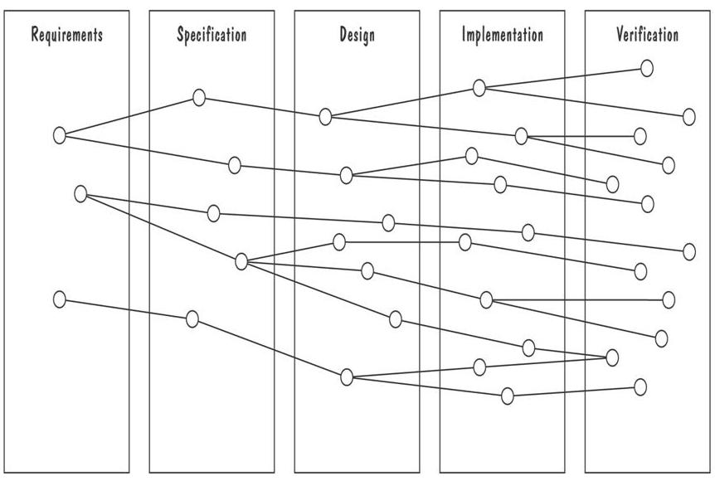
Requirements Documentation Development Activities and Traceability
Horizontal threads show the coordination between development activities

Slide 9
Validation and Verification
In requirements validation, we check that our requirements definition accurately reflects the customer's needs
In verification, we check that one document or artefact conforms to another
Verification ensures that we build the system right, whereas validation ensures that we build the right system

Slide 10
Validation and Verification List of techniques to validate requirements

Slide 11
Validation and Verification Requirements Review
Review the stated goals and objectives of the system
Compare the requirements with the goals and objectives
Review the environment in which the system is to operate
Review the information flow and proposed functions
Assess and document the risk, discuss and compare alternatives
Testing the system: how the requirements will be revalidated as the requirements grow and change

Slide 12
Validation and Verification
Check that the requirements-specification document corresponds to the requirements-definition
Make sure that if we implement a system that meets the specification, then the system will satisfy the customer's requirements
Ensure that each requirement in the definition document is traceable to the specification

Slide 13
Measuring Requirements
Measurements focus on three areas
product
process
resources
Number of requirements can give us a sense of the size of the developed system
Number of changes to requirements
Many changes indicate some instability or uncertainty in our understanding of the system
Requirement-size and change measurements should be recorded by requirements type

Slide 14
Measuring Requirements Rating Scheme on Scale from 1 to 5
You understand this requirement completely, have designed systems from similar requirements, and have no trouble developing a design from this requirement
Some elements of this requirement are new, but they are not radically different from requirements that have been successfully designed in the past
Some elements of this requirement are very different from requirements in the past, but you understand the requirement and can develop a good design from it
You cannot understand some parts of this requirement, and are not sure that you can develop a good design
You do not understand this requirement at all, and can not develop a design

Slide 15
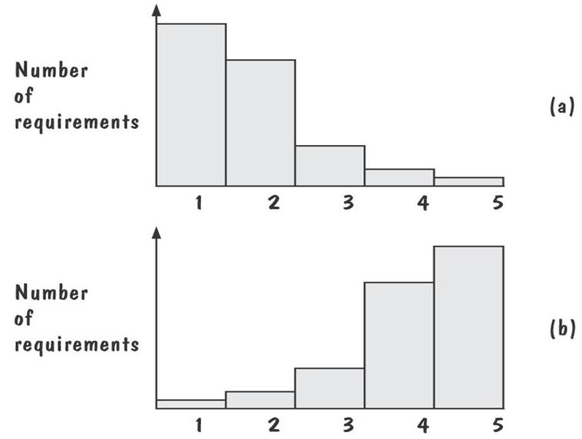
Measuring Requirements: Testers/Designers Profiles
Figure (a) shows profiles with mostly 1s and 2s
The requirements are in good shape
Figure (b) shows profiles with mostly 4s and 5s
The requirements should be revised

Slide 16
Choosing a Specification Technique Criteria for Evaluating Specification Methods
Applicability
Implementability
Testability/Simulation
Checkability
Maintainability
Modularity
Level of abstraction
Soundness
Variability
Run time safety
Tools maturity
Looseness
Learning curve
Technique maturity
Data modelling
Discipline

Slide 17
Choosing a Specification Technique Steps
Determine which of the criteria are especially important
Evaluate each of the candidate techniques with respect to the criteria
Choose a specification technique that best supports the criteria that are most important to the problem

Slide 18
Important of Specification Criteria During Reactive-System Life Cycle
R=Requirements, D=Design, I=Implementation, T=Testing, M=Maintenance, O=Other

Slide 19
Special THANK FOR THE MATERIALS
Mr. Haroon Abdul Waheed
Mr Sajid Saleem
Pfleeger’s Book slides from UCF
Software Fundamentals

